Slide 1
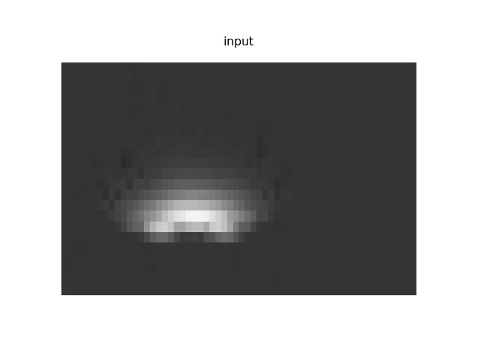
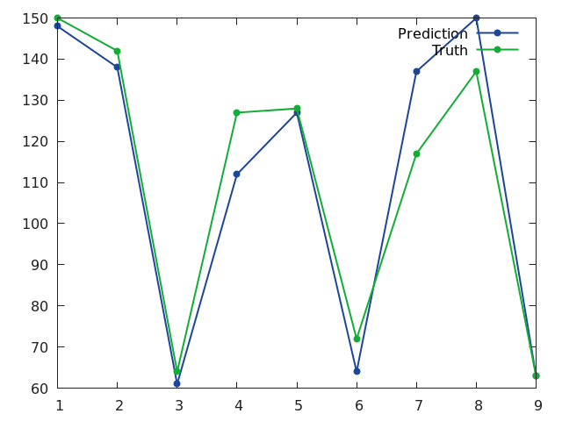
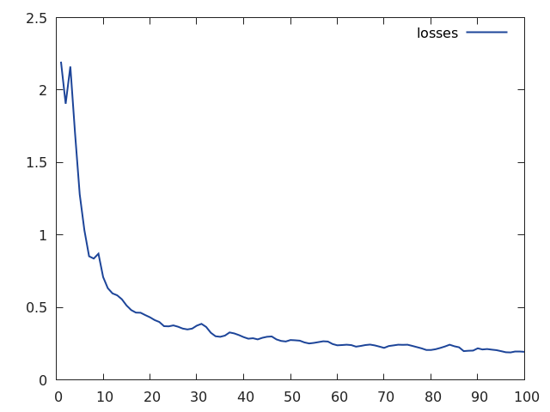
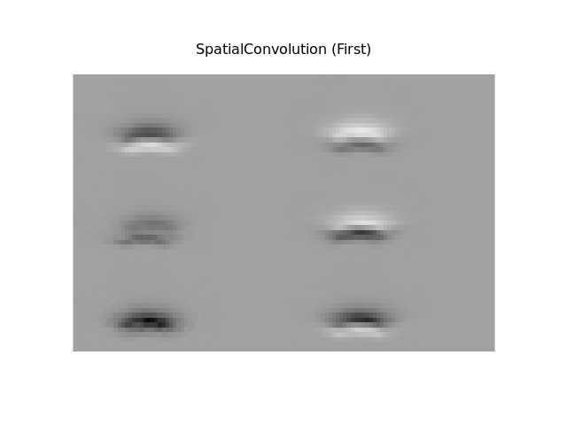
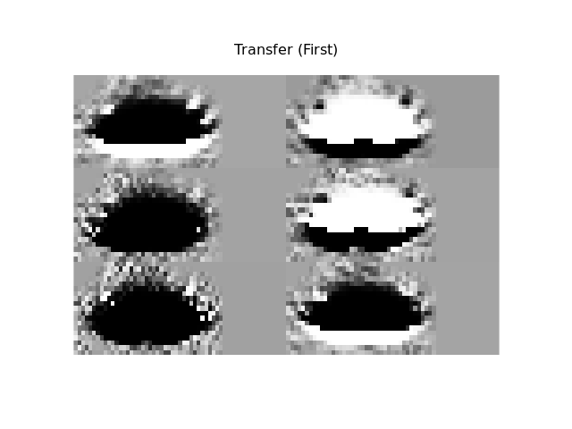
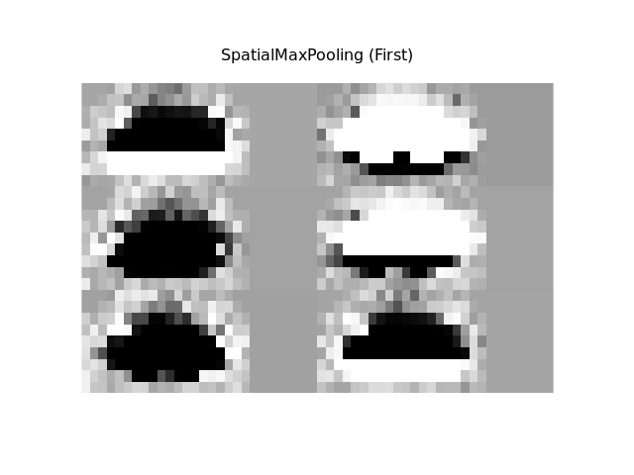
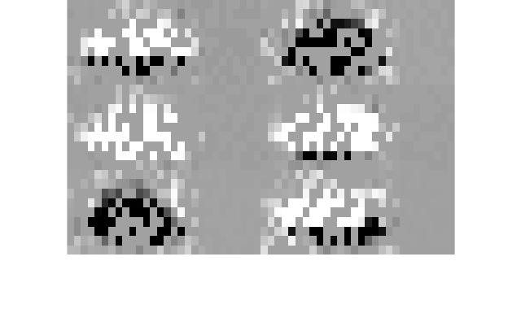
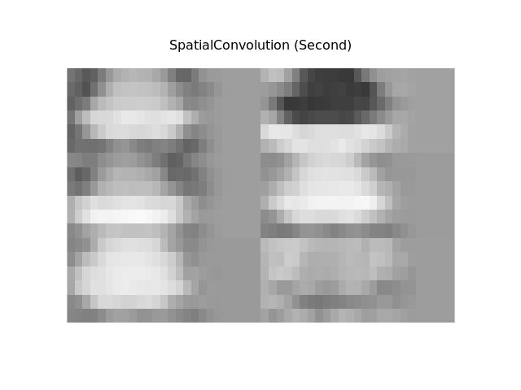

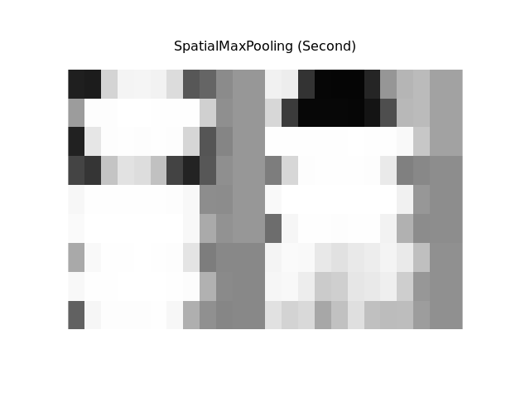
The NN:
nn.Sequential {
[input -> (1) -> (2) -> (3) -> (4) -> (5) -> (6) -> (7) -> (8) -> (9) -> (10) -> (11) -> output]
(1): nn.SpatialConvolution(1 -> 16, 4x4)
(2): nn.Tanh
(3): nn.SpatialMaxPooling(2x2, 2,2)
(4): nn.SpatialConvolution(16 -> 128, 4x4)
(5): nn.Tanh
(6): nn.SpatialMaxPooling(2x2, 2,2)
(7): nn.Reshape(4608)
(8): nn.Linear(4608 -> 200)
(9): nn.Tanh
(10): nn.Linear(200 -> 144)
(11): nn.LogSoftMax
}
Correct: 918 91.8 %
classe # truth # prediction # performance # perf/truth (%)
1 150 148 145 96.666666666667
2 142 138 133 93.661971830986
3 64 61 60 93.75
4 127 112 110 86.614173228346
5 128 127 108 84.375
6 72 64 61 84.722222222222
7 117 137 116 99.145299145299
8 137 150 125 91.240875912409
9 63 63 57 90.47619047619
Dropout Example...
image 13 guess 8
1 -9.0125818252563
2 -9.6329498291016
3 -10.419324874878
4 -8.5462665557861
5 -5.9118123054504
6 -8.6866769790649
7 -6.5212693214417
8 -0.012678146362305
9 -4.8486533164978

